Slide 1
Notes:
(Feel free to use this slide as an opener. Play some fun jams as people wait for the presentation to start!)

Slide 2
AMA SPOTLIGHT:
Health Equity
Notes:
Good morning/afternoon everyone! We are excited to have you all join us today as we talk about a REALLY important topic...health equity.

Slide 3
Today’s Agenda
Introduction of chapter leadership
What is health equity?
How does organized medicine impact health equity?
How do I get involved?
Notes:
Today, we'll:
Introduce your chapter leadership
Talk about what health equity is
Discuss the impact of organized medicine on health equity
And, show you ways to get involved!

Slide 4
Meet your AMA Leadership at <School> !
Notes:
(CUSTOMIZE THIS SLIDE: Replace the school placeholder <School> with your school name and remove yellow highlight)
So, let's meet your chapter leadership!

Slide 5
Your AMA Executive Board At <School>
President:
Co-President:
Vice President:
Financial Officer:
Membership Chair:
Diversity Chair:
OL Update: Add/edit information and/or photo
Notes:
(CUSTOMIZE THIS SLIDE: Replace school placeholder <School> in the header, add student name & email for each position. Add more positions, if offered at your section. And, add a fun photo, if you have one. If not, add your school logo. Remove yellow highlighting.)
We have a really great and active leadership team at (insert school name)! They're/we're here to help answer your questions and support you throughout the year.
(Introduce members/go through the list)

Slide 6
<Presenter Name>, <Leadership Position>
Introduce yourself
Year in school
Potential area of study/rotations
Involvement with AMA
What is your top reason to be a part of the AMA
Fun Fact about yourself!
Add photo(s) of yourself here showing off AMA or medical school activities.
Add slide per presenter/OL
Notes:
(CUSTOMIZE THIS SLIDE: Replace placeholders in the header with your name and position. Replace the bullet points to reflect you. And, add a fun photo, if you have one. Remove yellow highlighting. Repeat this slide for each presenter, if you have multiple presenters.)

Slide 7

Notes:
Ok, let me kick off an introduction of the AMA with a quick highlight video!
Link: https://youtu.be/zi9sPgepeWY

Slide 8
What is the American Medical Association?
Notes:
So, you've probably heard of the American Medical Association before, but let's talk in more detail about what it is and what it does for the field of medicine.

Slide 9

The AMA is the physicians’ powerful ally in patient care, representing physicians with a unified voice,
leading the charge to confront public health crises, removing obstacles that interfere with patient care and driving the future of medicine.
Notes:
The AMA's mission statement really summarizes what the organization is all about and what it is focused on. Let me read it for you:
The AMA is the physicians' powerful ally in patient care, representing physicians with a unified voice, leading the charge to confront public health crises, removing obstacles that interfere with patient care and driving the future of medicine.

Slide 10


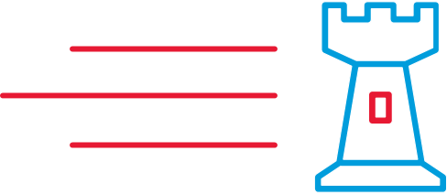


Representing physicians with a unified voice
Removing obstacles that interfere with patient care
Leading the charge to confront public health crises
Driving the Future of Medicine
Notes:
So, what does that mean? How does the AMA bring their mission to life in the work they do?
Well, they focus on four pillars where they can have impact and make a difference.
First, they represent med students, residents and physicians with a unified voice:
Medical students, residents and physicians are active and well-represented in the AMA House of Delegates, at the National Advocacy Conference, in AMA policy-making, through Congressional testimony and in many other key places designed to bring positive change to medicine.
Second, they remove obstacles that interfere with patient care:
For example, the AMA helped lead the charge to make medical records electronic
Another example is their work in the removal of Prior Authorization practices which are overused, costly and directly responsible for patient care delays
Third, they are leading the charge to confront public heath crises, like:
Preventing diabetes
Managing hypertension
And, addressing the opioid crisis head-on
And, last, they are driving the future of medicine:
The AMA is reinventing the way future physicians are trained by actively engaging in med ed innovation, driving an emphasis on work life/ balance, and eliminating med student, resident and physician burnout
They are committed to the health and support of the nation's healthcare providers with an eye toward continuous improvement in the field of medicine

Slide 11

AMA = Sum Of 5 Parts
House of Delegates
(policy)
Practice/
Business
Tools
Research & Education
Members
Advocacy
INNOVATION ECOSYSTEM
Our Mission: The American Medical Association promotes the art and science of medicine and the betterment of public health.
Notes:
The AMA's mission is to promote the art and science of medicine and the betterment of public health. They are a large, widely-recognized organization with locations and voices across the country. With their strong brand, they are able to recruit top talent to support their mission and are a driving force in healthcare policy, research and education, as well as advocacy efforts.

Slide 12
What is Health Equity?
Notes:
So, let’s talk about health equity. What exactly IS it?

Slide 13
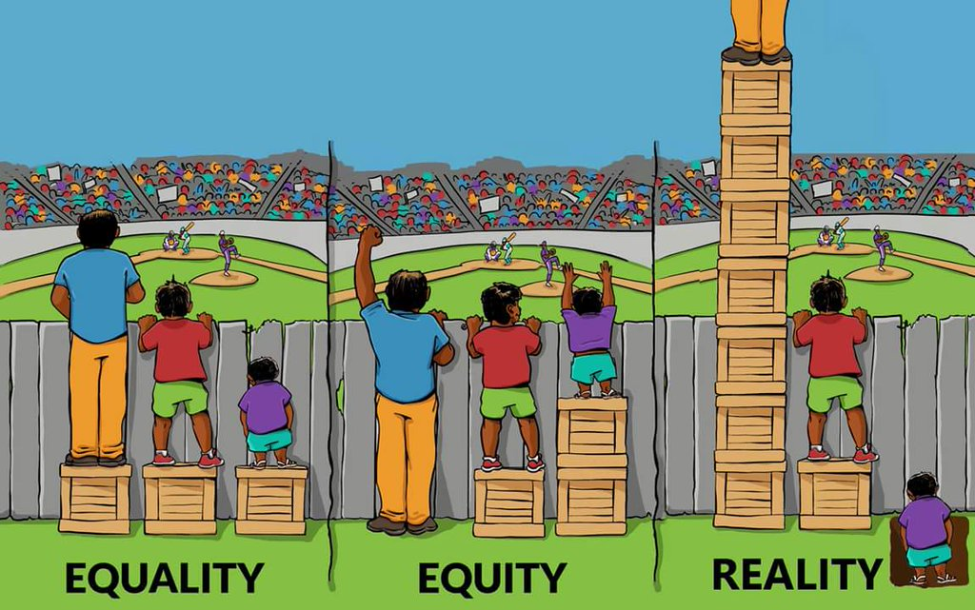
Notes:
Let’s start with what it is not.
Equity is not equality. Equality is the philosophy of “to each, the same thing.” And, that’s what you see here in the picture on the left.
According to the World Health Organization, equity is "the absence of avoidable or remediable differences among groups of people, whether those groups are defined socially, economically, demographically or geographically.“
The opposite of equity is inequity. The Centers for Disease Control and Prevention note that inequities are “types of unfair health differences closely linked with social, economic or environmental disadvantages that adversely affect groups of people.”
Basically, equity is the process that considers structural barriers and creates pathways so people receive what they need. Equity is the philosophy of “to each according to need.” That’s the experience you see here in the middle picture.
In reality, there are big differences between the experiences of groups that have experienced advantage and the experiences of marginalized and minoritized groups that have experienced disadvantage. That’s the Reality of Picture 3.

Slide 14

What is Heath Equity?
Health equity means that everyone has a fair and just opportunity to be as healthy as possible. This requires removing obstacles to health such as poverty, discrimination, and their consequences, including powerlessness and lack of access to good jobs with fair pay, quality education and housing, safe environments, and health care.
Equity is the absence of avoidable or remediable differences among groups of people, whether those groups are defined socially, economically, demographically, or geographically.
The route to achieving equity will not be accomplished through treating everyone equally. It will be achieved by treating everyone justly according to their circumstances
Robert Johnson Woods Foundation
World Health Organization
Paula Dressel
Notes:
According to the CDC, health equity is when each person has the chance to reach “his or her full health potential” without facing obstacles from “social position or other socially determined circumstances.” This includes equitable (fair) access to healthcare professionals, healthy food, a safe living environment, and the ability to be well across all aspects of life, from work to home life to medical care. Equity matters because it impacts how resources are distributed.

Slide 15
The AMA & Health Equity
Notes:
So, where does the AMA stand on health equity?

Slide 16
The American Medical Association is the nation’s largest professional association of physicians. We are a unifying voice and we are physicians’ powerful ally in patient care.
Fulfilling our AMA’s mission to promote the art and science of medicine and the betterment of public health requires an unwavering commitment to equity and a comprehensive strategy for embedding racial and social justice within our organization and domains of influence.
Advancing health equity through our AMA’s efforts entails a dedicated, coordinated and honest approach. It recognizes the harmful effects of our past and targets the systemic inequities in our health care system and other social institutions. And it charts a path toward a more promising and equitable future for all.
This is AMA’s first strategic plan dedicated to embedding racial justice and advancing health equity.
Notes:
In May of 2021, the AMA launched an ambitious 3-year strategic initiative addressing health equity and how the AMA will champion this cause (read statement).

Slide 17
AMA Works to Create Greater Health Equity in America
Policy
Advocacy
Tools
The AMA’s House of Delegates has adopted dozens of policies calling for: reducing racial and ethnic disparities in health care; increasing diversity in the medical profession; and eliminating bias among health professionals.
The AMA advocates for policies, such as expanded access to care for all, and for adequate funding of safety net programs.
The AMA creates tools such as the Health Disparities Toolkit, for physicians to use to implement better health literacy and culturally competent care in their own practices.
Notes:
The framework of the plan—which is central to the work of the AMA Center for Health Equity and is the responsibility of AMA leadership, membership, and external stakeholders—was driven by the need for equity-centered solutions to confront harms produced by systemic racism and other forms of oppression for Black, Latinx, Indigenous, Asian, and other people of color, as well as people who identify as LGBTQ+ and people with disabilities.
The AMA is taking a very active role in supporting social wellness movements, health advocacy efforts and health policies that embed equity.

Slide 18


AMA Center for Health Equity
The AMA commits to advancing greater equity in medicine with 5 strategic actions to advance equity & justice, address systemic inequities & work to improve patient outcomes and quality of care for all.
Notes:
The groundwork for the plan began in 2019 when the AMA Center for Health Equity was launched as a result of a resolution passed by the AMA’s House of Delegates. Its urgency is underscored by ongoing circumstances including inequities exacerbated by the COVID-19 pandemic, ongoing police brutality, and hate crimes targeting Asian, Black, and Brown communities.

Slide 19

The 5 Pillars of AMA’s Equity Initiatives
Notes:
The plan outlines five strategic approaches to begin tackling these challenges:
Embed equity and racial justice throughout the AMA by expanding capacity for understanding and implementing anti-racist equity strategies via practices, programming, policies, and culture.
Build alliances with marginalized physicians and other stakeholders through developing structures and coalitions to elevate the experiences and ideas of historically marginalized and minoritized health care leaders.
Push upstream to address all determinants of health and root causes of inequities by strengthening, empowering, and equipping physicians with the knowledge of and tools for dismantling structural and social drivers of health inequities.
Ensure equitable structures and opportunities in innovation through embedding and advancing racial justice and health equity within existing AMA efforts to advance digital health.
Foster pathways for truth, racial healing, reconciliation, and transformation for AMA’s past by accounting for how policies and processes excluded, discriminated, and harmed communities, and by amplifying and integrating the narratives of historically marginalized physicians and patients.

Slide 20
Immediate Goals for the AMA's Center of Health Equity
Building public health infrastructure
Improving access to affordable, equitable healthcare
Telehealth flexibility
Health equity-centered policies
Mental health and substance use treatment parity
Ending maternal morbidity and mortality
Expanding COVID-19 relief
Notes:
Immediate goals for the AMA’s Center of Health Equity include (read bullet points).

Slide 21

Continued AMA Health Equity Initiatives
AMA Foundation – Minority Affairs Section scholarships for fourth-year medical students
Doctors Back to School™ Program
Year-round pipeline program
Physicians visit schools to encourage young students to consider careers in medicine
AMA Policy: Racism is a threat to public health
Notes:
The AMA continues to focus on health equity initiatives already in place, including (read bullets).

Slide 22

Impact of AMA LGBTQ+ Health Advocacy
Judicial
Filing amicus briefs in Supreme Court and Appellate Court cases involving LGBTQ health, protections from discrimination and human rights.
Executive
Advocating for LGBTQ-inclusive and non-discriminatory policies through correspondence with public officials and submitting public comments on proposed rules of various federal agencies.
Legislative
Supporting medical societies in federal and state legislative efforts that impact LGBTQ patient outcomes.
Notes:
And, the AMA continues to have impact in the health equity space, including these examples as relate to LGBTQ+ advocacy (read bullets).

Slide 23
Truth And Reconciliation
“Today, on behalf of the American Medical Association,
I unequivocally apologize for our past behavior. We pledge to do everything in our power to right the wrongs that were done by our organization to African-American physicians and their families and their patients.”
2008, Ronald M. Davis, MD, Past AMA President
Notes:
The AMA has owned its past and is focused on making change to have positive impact on the future.

Slide 24
How Can I Get Involved?
Notes:
Let's talk about how to get involved with our chapter and as a student at the AMA!

Slide 25

Medical Student Involvement At The AMA
Become a Member
Get involved at our <Med School> Chapter
Get involved at your state medical society
Get involved at the regional level
Take on an AMA leadership position
Medical Student Outreach Program
Medical Student Section
AMA Ambassadors
Notes:
(CUSTOMIZE THIS SLIDE: Replace <Med School> with your school name. Remove the yellow highlights.)
So, what now? Where do you begin? It's easy!
The first step is to become an AMA member. You can sign up at ama-assn.org/msop-join. Remember, membership comes with lots of benefits in addition to getting involved!
Next, get involved with the chapter and your state medical society.
Finally, take advantage of hundreds of leadership opportunities at the AMA. Some of those include:
Campus Outreach Leader positions with the AMA Medical Student Outreach Program to recruit and engage student members
Standing Committee roles through the MSS (Medical Student Section), which is heavily involved in advocacy and policy
Ambassador positions, to spread the word about the AMA to anyone who wants to hear!
And, many more!
Let me know if you want to learn more about any of these leadership opportunities (they look great on your CV, by the way!) and I'll connect you to the AMA's Medical Student Outreach Team!

Slide 26
Join Your Local Chapter <Medical School> Information & Events
What has the chapter been doing?
Highlights of last year?
Pictures
Medical school to add more information about their chapter
OL Update: AMA Chapter will update page with what their chapters are doing and any photos they want to add
Notes:
(CUSTOMIZE THIS SLIDE: Replace <Medical School> in the header with your school name. Add details on the great things your chapter has been doing and include photos. Remove the yellow highlights.)
Talk about why it's important for your chapter to grow! Give examples of how they can get involved and why it makes a difference.

Slide 27
Get Involved With Your State Society!
Its important to be involved both nationally and locally.
The AMA encourages you to become a member at <Insert Your State Society>.
<If you have partnered with State Society put any information you want to articulate here>
Insert State Society Logo Here
Notes:
(CUSTOMIZE THIS SLIDE: Replace highlighted text areas with your relevant information. Add your state society logo. Remove all yellow highlights.)
Talk about the work your state society does and how you/your chapter have partnered with them! Give examples of how they can get involved and why it makes a difference.

Slide 28
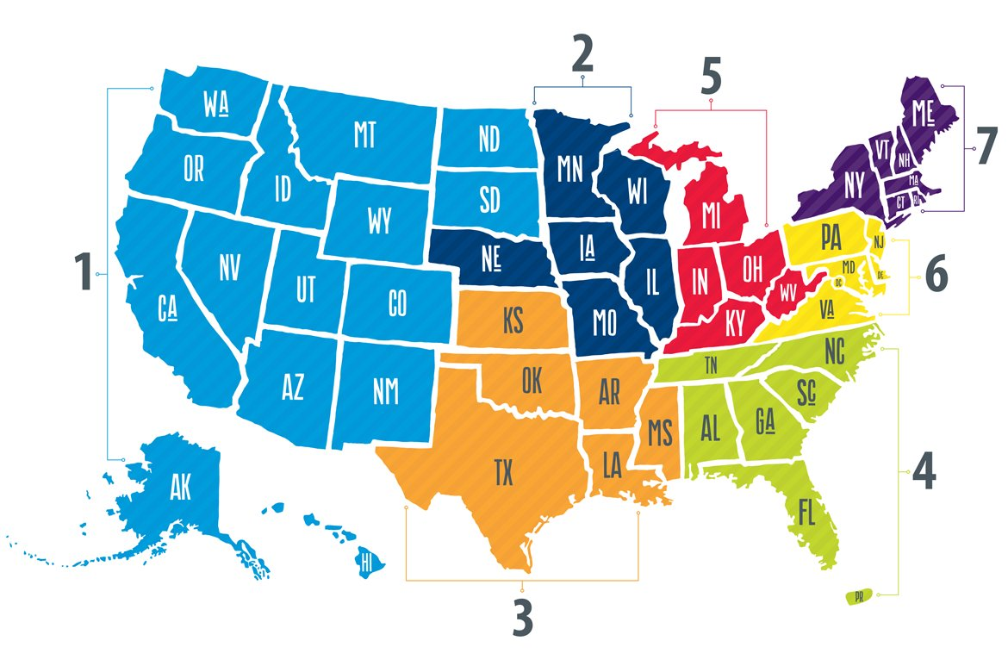

Regional Involvement
Notes:
Talk about how your chapter is involved at the regional level. Give examples of how they can get involved and why it makes a difference.

Slide 29
AMA Student Member Benefits
Notes:
So, that's all great, but what are some of the student-specific benefits of becoming an AMA member?

Slide 30



Why Join as a Medical Student?
You know medicine moves at a fast pace. But now you can keep ahead with a wealth of resources to stay up to date and at your professional best.
You know medicine moves at a fast pace. But now you can keep ahead with a wealth of resources to stay up to date and at your professional best.
Participate in education sessions and workshops at AMA events
Apply for scholarships, internships and fellowships with the FDA and AMA Foundation, along with a variety of leadership opportunities
Take advantage of members-only discounts for study aids, travel, wellness and more
Notes:
There are many benefits to joining the AMA as a medical student, including:
Networking and building community
Leadership development
Educational opportunities
And, of course, some great discounts and incentives!
(When talking about these on the next few slides, feel free to TELL YOUR STORY! Tell the audience what you have benefited from or what things you have used/taken advantage of!)

Slide 31



Why Join As A Medical Student?
Networking and Leadership:
Mentorship with medical professionals
Community building with medical students
Attend conferences
Educational Benefits:
FREIDA and residency help
Workshops
Webinars
Journal access
Research opportunities
Resume Builders:
Leadership opportunities
Scholarships
Internships
Fellowships
Lifestyle and Travel Discounts
Loan planning
Study prep materials
30% off Kaplan discounts
Headspace
Notes:
Let's break the benefits down (go through list)…
As you can see, there are many great reasons to consider AMA membership in addition to having your voice heard and shaping the future of medicine!

Slide 32


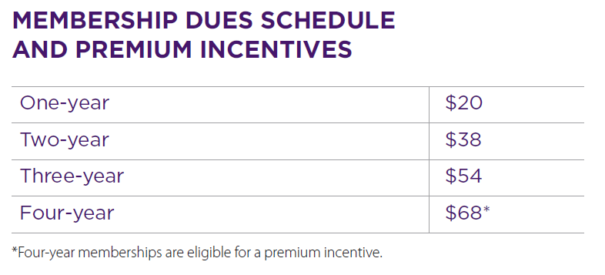

Joining The AMA
ama-assn.org/msop-join
Notes:
So, we've talked about how becoming an AMA member gives you opportunity to have a voice in the future of medicine and fight for issues that matter to you. We've also talked about the many other benefits that come with membership, including discounts and more.
But, what does it cost? Actually, student memberships are really reasonable, as you can see in this chart. And, a 4-year membership is the best deal because you also receive a welcome gift of your choice, which includes popular study guides or subscriptions that can be helpful in your medical school journey.

Slide 33

Notes:
If you are ready to be a part of an organization that will continue to impact your career through support, networking, and advocacy, sign up right now! The AMA will be there for you throughout med school and well into your years as a practicing physician.
Joining is easy! Just pull out your phone or open up a new tab and go to ama-assn.org/msop-join and sign up today! We are here to answer any questions!

