Slide 1
Notes:
(Feel free to use this slide as an opener. Play some fun jams as people wait for the presentation to start!)

Slide 2
AMA Advocacy
& YOU!

Slide 3
Today’s Agenda
Introduction of chapter leadership
What is advocacy?
How does organized medicine impact advocacy?
How do I get involved in advocacy?
Notes:
Today we will be talking about Advocacy! Specifically, we’ll:
Introduce your chapter leadership
Define what advocacy is
Discuss how organized medicine impacts advocacy
And, talk about ways you can get involved in advocacy initiatives

Slide 4
Meet your AMA Leadership at <School> !
Notes:
(CUSTOMIZE THIS SLIDE: Replace the school placeholder <School> with your school name and remove yellow highlight)
So, let's meet your chapter leadership!

Slide 5
Your AMA Executive Board at <School>
President:
Co-President:
Vice President:
Financial Officer:
Membership Chair:
Diversity Chair:
OL Update: Add/edit information and/or photo
Notes:
(CUSTOMIZE THIS SLIDE: Replace school placeholder <School> in the header, add student name & email for each position. Add more positions, if offered at your section. And, add a fun photo, if you have one. If not, add your school logo. Remove yellow highlighting.)
We have a really great and active leadership team at (insert school name)! They're/we're here to help answer your questions and support you throughout the year.
(Introduce members/go through the list)

Slide 6
<Presenter Name>, <Leadership Position>
Introduce yourself
Year in school
Potential area of study/rotations
Involvement with AMA
What is your top reason to be a part of the AMA
Fun Fact about yourself!
Add photo(s) of yourself here showing off AMA or medical school activities.
Add slide per presenter/OL
Notes:
(CUSTOMIZE THIS SLIDE: Replace placeholders in the header with your name and position. Replace the bullet points to reflect you. And, add a fun photo, if you have one. Remove yellow highlighting. Repeat this slide for each presenter, if you have multiple presenters.)

Slide 7

Notes:
Ok, let me kick off an introduction of the AMA with a quick highlight video!
Link: https://youtu.be/KsoFO4-43WM

Slide 8
What is the American Medical Association?
Notes:
So, you've probably heard of the American Medical Association before, but let's talk in more detail about what it is and what it does for the field of medicine.

Slide 9

The AMA is the physicians’ powerful ally in patient care, representing physicians with a unified voice,
leading the charge to confront public health crises, removing obstacles that interfere with patient care and driving the future of medicine.
Notes:
The AMA's mission statement really summarizes what the organization is all about and what it is focused on. Let me read it for you:
The AMA is the physicians' powerful ally in patient care, representing physicians with a unified voice, leading the charge to confront public health crises, removing obstacles that interfere with patient care and driving the future of medicine.

Slide 10


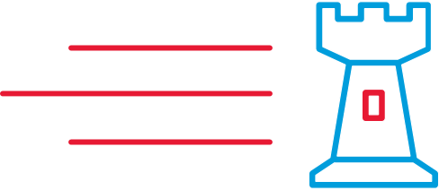


Representing physicians with a unified voice
Removing obstacles that interfere with patient care
Leading the charge to confront public health crises
Driving the Future of Medicine
Notes:
So, what does that mean? How does the AMA bring their mission to life in the work they do?
Well, they focus on four pillars where they can have impact and make a difference.
First, they represent med students, residents and physicians with a unified voice:
Medical students, residents and physicians are active and well-represented in the AMA House of Delegates, at the National Advocacy Conference, in AMA policy-making, through Congressional testimony and in many other key places designed to bring positive change to medicine.
Second, they remove obstacles that interfere with patient care:
For example, the AMA helped lead the charge to make medical records electronic
Another example is their work in the removal of Prior Authorization practices which are overused, costly and directly responsible for patient care delays
Third, they are leading the charge to confront public heath crises, like:
Preventing diabetes
Managing hypertension
And, addressing the opioid crisis head-on
And, last, they are driving the future of medicine:
The AMA is reinventing the way future physicians are trained by actively engaging in med ed innovation, driving an emphasis on work life/ balance, and eliminating med student, resident and physician burnout
They are committed to the health and support of the nation's healthcare providers with an eye toward continuous improvement in the field of medicine

Slide 11

AMA = Sum of 5 Parts
House of Delegates
(policy)
Practice/
Business
Tools
Research & Education
Members
Advocacy
INNOVATION ECOSYSTEM
Our Mission: The American Medical Association promotes the art and science of medicine and the betterment of public health.
Notes:
The AMA's mission is to promote the art and science of medicine and the betterment of public health. They are a large, widely-recognized organization with locations and voices across the country. With their strong brand, they are able to recruit top talent to support their mission and are a driving force in healthcare policy, research and education, as well as advocacy efforts.

Slide 12
What is Advocacy?
Notes:
So, what do YOU think advocacy means?
(let them answer and sum up by telling them those are all good definitions)

Slide 13

Advocacy
All advocacy is, at its core, an exercise in empathy.” - Samantha Power, Former Ambassador
“Every great dream begins with a dreamer. Always remember, you have within you the strength, the patience and the passion to reach for the stars to change the world.”
Harriet Tubman
“When the world is silent, even one voice becomes powerful.”
- Malala Yousafzai
Notes:
Here are some powerful quotes that, I think, really illustrate the meaning of advocacy (read quotes).

Slide 14
The AMA is your Healthcare Advocacy Partner
Notes:
One of the biggest questions the AMA gets from medical students is what role the AMA plays in healthcare advocacy. The answer is that the AMA plays a BIG role in advocating for students, residents, physicians AND patients.
As a healthcare advocacy organization made up of dedicated and engaged physicians, the AMA is a leading voice that informs lawmakers, and guides and generates support for policies on critical issues that impact physicians, patients and the healthcare environment at both the national and state levels.
(Get the audience involved: ask them "What are your passions around advocacy?" Have them speak out or type them into the chat and read them out as they come in.)

Slide 15
The AMA is your Healthcare Advocacy Partner
Identifying Police Brutality as a national health issue.
Defending Title X
Advocating for DACA
Protecting Patient’s Access to Care
Increasing Racial and Ethnic Diversity in Medicine
LGBTQ+ Health Advocacy
Addressing Issues of Smoking/Vaping
Addressing Immigration and Health Care Issues
Creating Policy Around Gun Ownership & Gun Violence
Working Initiatives for Rx pricing practices and oversight
Notes:
The AMA has recently taken a stance on many issues affecting public health. So, what are some of the issues they've worked on? Here are just a few examples (read from the slide list or give an example or two from below):
•AMA Supports DACA - As the nation’s doctors, nurses and other health care heroes fought a pandemic, the U.S. Supreme Court grappled with a case that could remove about 27,000 health professionals from the battlefield—including 200 medical students, residents and physicians. The Litigation Center of the American Medical Association and State Medical Societies joined more than 30 other organizations in filing a brief in the case, Department of Homeland Security v. Regents of the University of California, to urge the court to stop the Trump administration from ending DACA.
•AMA Stance on Police Brutality - AMA policy recognizes that physical or verbal violence between law enforcement officers and the public, particularly among Black and Brown communities, where these incidents are more prevalent and pervasive, is a critical determinant of health and supports research into the public health consequences of these violent interactions.
•During COVID - the AMA was at the vanguard of efforts to expand and improve healthcare coverage for the underinsured and uninsured in the US.

Slide 16

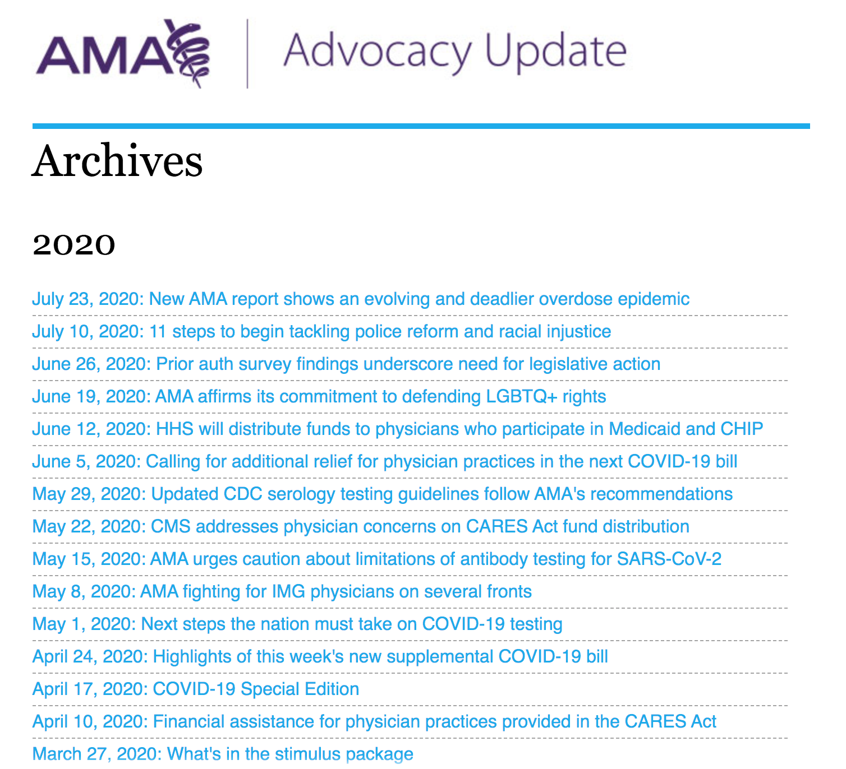



AMA Advocacy Unit
Notes:
In fact, the AMA has a xx advocacy team

Slide 17


Writing Resolutions into Policy
YOU
Individual, group, or chapter writes a resolution. Resolution is sent to MSS for a vote!
MSS
Resolution passes in the MSS and Becomes MSS Policy!
Resolution I s sent to HOD for a vote!
HOD
Resolution passes in the HOD and becomes AMA Policy!
Now the action Begins!
AMA
RESULT
AMA Leadership, lobbyists and staff take action on the policy!
AMA Lobbies Government; AMA Utilizes Media; Influence; Publishes information
Resolution Becomes Policy!

Slide 18
Adoption and Implementation of New AMA Policy
Resolutions adopted at the HOD Meetings are incorporated into AMA Policy
Key Dimensions of AMA Policy:
- The processes through which AMA policy positions are established
- The processes used to record and disseminate AMA policy
- The activities through which the AMA promotes and advocates its policy positions
The AMA utilizes our advocacy efforts to promote AMA policy positions in a multitude of ways
Communication to the Public
AMA representation on standard-setting and accreditation bodies
Legislative process at the national and state levels
Litigation
Advocacy campaigns at the national and state levels
Advocacy in the private sector
Advocacy to regulatory bodies

Slide 19


What Happens Next? Impact of Adopted AMA Resolution

Slide 20




Student Advocacy in Action
Opposition of Smoking on Airplanes
Became National Policy
Affirming Medical Spectrum of Gender
Considering Feminine Hygiene Products as Medical Necessities
Improving Medical Care in Immigrant Detention Centers
Defending Federal Child Nutrition Programs
Equality for COMLEX and USMLE
Opposition to Medicaid Work Requirements
Decriminalization of HIV Status Non-Disclosure

Slide 21
2021 AMA Advocacy Priorities
Building Public Health Infrastructure
Improving Access to Affordable, Equitable Healthcare
Telehealth Flexibility
Health Equity Centered Policies
Mental Health and Substance Use Treatment Parity
Ending Maternal Morbidity and Mortality
Expanding COVID-19 Relief
Notes:
List specific priorities at your state

Slide 22
How Can I Get Involved?
Notes:
Let's talk about how to get involved with our chapter and as a student at the AMA!

Slide 23

Medical Student Involvement at the AMA
Become a Member
Get involved at our <Med School> Chapter
Get involved at your state medical society
Get involved at the regional level
Take on an AMA leadership position
Medical Student Outreach Program
Medical Student Section
AMA Ambassadors
Notes:
(CUSTOMIZE THIS SLIDE: Replace <Med School> with your school name and remove the yellow highlighting.)
So, what now? Where do you begin? It's easy!
The first step is to become an AMA member. You can sign up at ama-assn.org/msop-join. Remember, membership comes with lots of benefits in addition to getting involved!
Next, get involved with the chapter and your state medical society.
Finally, take advantage of hundreds of leadership opportunities at the AMA. Some of those include:
Campus Outreach Leader positions with the AMA Medical Student Outreach Program to recruit and engage student members
Standing Committee roles through the MSS (Medical Student Section), which is heavily involved in advocacy and policy
Ambassador positions, to spread the word about the AMA to anyone who wants to hear!
And, many more!
Let me know if you want to learn more about any of these leadership opportunities (they look great on your CV, by the way!) and I'll connect you to the AMA's Medical Student Outreach Team!

Slide 24
Join Your Local Chapter <Medical School> Information & Events
What has the chapter been doing?
Highlights from last year?
Pictures
Medical school to add more information about their chapter
OL Update: AMA Chapter will update page with what their chapters are doing and any photos they want to add
Notes:
(CUSTOMIZE THIS SLIDE: Replace <Medical School> in the header with your school name. Add details on the great things your chapter has been doing and include photos. Remove the yellow highlights.)
Talk about why it's important for your chapter to grow! Give examples of how they can get involved and why it makes a difference.

Slide 25



Why Join as a Medical Student?
You know medicine moves at a fast pace.
Keep ahead with a wealth of resources to stay up to date and at your professional best
Participate in education sessions and workshops at AMA events
Apply for scholarships, internships and fellowships with the FDA and AMA Foundation, along with a variety of leadership opportunities
Take advantage of members-only discounts for study aids, travel, wellness and more
Notes:
Well, there are many benefits to joining the AMA as a medical student, including:
Networking and building community
Leadership development
Educational opportunities
And, of course, some great discounts and incentives!
(When talking about these on the next few slides, feel free to TELL YOUR STORY! Tell the audience what you have benefited from or what things you have used/taken advantage of!)

Slide 26



Why Join as a Medical Student?
Networking and Leadership:
Mentorship with medical professionals
Community-building with medical students
Attend conferences
Educational Benefits:
FREIDA and residency help
Workshops
Webinars
Journal access
Research opportunities
Resume Builders:
Leadership opportunities
Scholarships
Internships
Fellowships
Lifestyle and Travel Discounts
Loan Planning
Study prep materials
30% off Kaplan discounts
Headspace
Notes:
Let's break the benefits down (go through list)…
As you can see, there are many great reasons to consider AMA membership in addition to having your voice heard and shaping the future of medicine!

Slide 27
Get Involved with your State Society!
It's important to be involved both nationally and locally.
The AMA encourages you to become a member at <Insert Your State Society>
<If you have partnered with State Society put any information you want to articulate here>
Insert State Society Logo Here
Notes:
(CUSTOMIZE THIS SLIDE: Replace highlighted text areas with your relevant information. Add your state society logo. Remove all yellow highlights.)
Talk about the work your state society does and how you/your chapter have partnered with them! Give examples of how they can get involved and why it makes a difference.

Slide 28
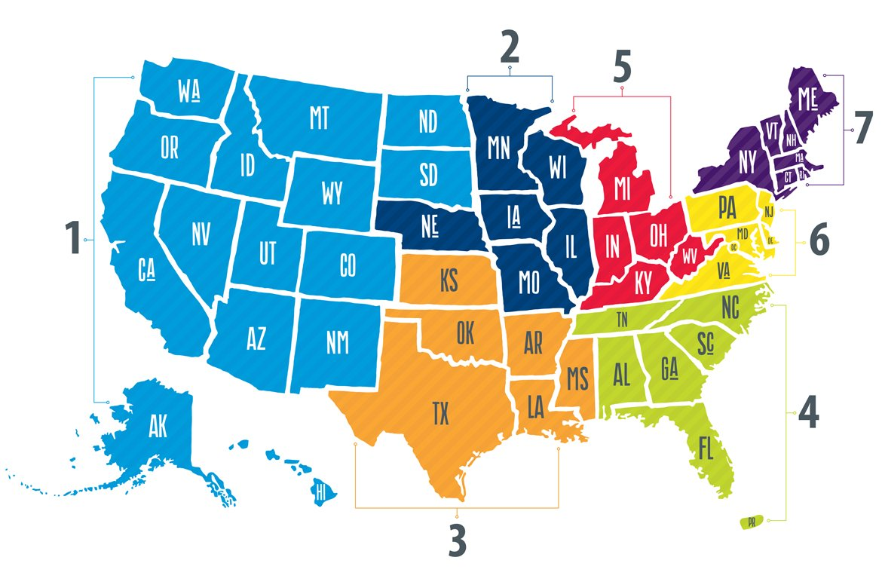

Regional Involvement
Notes:
Talk about how your chapter is involved at the regional level. Give examples of how they can get involved and why it makes a difference.

Slide 29


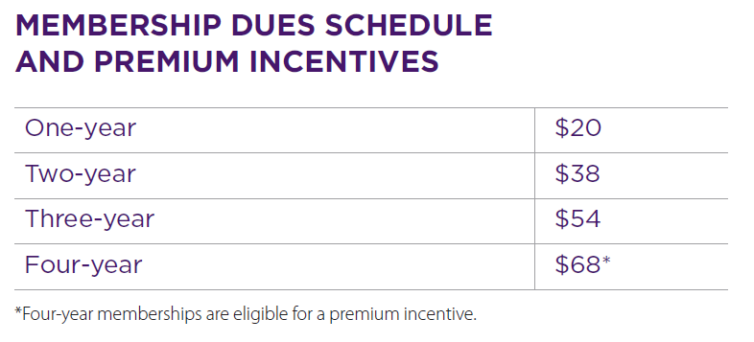

Joining the AMA
ama-assn.org/msop-join
Notes:
So, we've talked about how becoming an AMA member gives you opportunity to have a voice in the future of medicine and fight for issues that matter to you. We've also talked about the many other benefits that come with membership, including discounts and more.
But, what does it cost? Actually, student memberships are really reasonable, as you can see in this chart. And, a 4-year membership is the best deal because you also receive a welcome gift of your choice, which includes popular study guides or subscriptions that can be helpful in your medical school journey.

Slide 30
Advocacy Resources At The AMA
Advocacy/Policy Teams Channel (compiled by Reilly, would highly recommend signing up): https://docs.google.com/forms/d/e/1FAIpQLScyeBu8H8ZS4UkB4qB9jVgrXkl_rRpwfT19D7BrsSQT3rCMtg/viewform?fbclid=IwAR286SX-JKqlJKsxVXYrO5oexdV1F_XObMh0qMeDmQp-5XiGTQfQSUhmlmE
AMA Medical Student Section Page (includes links for school chapters, standing committees, and section involvement grants): https://www.ama-assn.org/member-groups-sections/medical-students
AMA Advocacy Update (follow along with our advocacy efforts at the federal, state, and judicial level): https://assets.ama-assn.org/sub/advocacy-update/archive.html
AMA COVID-19 Resource Page (check out the resource guides for residents and students): https://www.ama-assn.org/delivering-care/public-health/covid-19-2019-novel-coronavirus-resource-center-physicians
AMA Social Media Accounts (give them a follow if you haven’t already):
AMA Twitter: https://twitter.com/AmerMedicalAssn
AMA Med Students: https://twitter.com/AMAmedstudents
AMA Instagram: https://www.instagram.com/amermedicalassn/
AMA Mask-Up Campaign (#MaskUp | Wear a Mask | Socially Distance | Wash Your Hands): https://www.ama-assn.org/delivering-care/coronavirus/mask-stop-spread-covid-19
Notes:
Here are some great resources you should bookmark! Don't worry we can email this list after the presentation (or drop in chat)

Slide 31
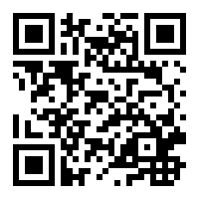
Notes:
If you are ready to be a part of an organization that will continue to impact your career through support, networking, and advocacy, sign up right now! The AMA will be there for you throughout med school and well into your years as a practicing physician.
Joining is easy! Just pull out your phone or open up a new tab and go to ama-assn.org/msop-join and sign up today! We are here to answer any questions!

