Slide 1


AMA 101 EVENT
Get to know the American Medical Association!
<Name of School LINE 1>
<Name of School LINE 2>
Stella Udoetuk, future physician
Member since 2020
Melody Chiang, future physician
Member since 2022
Kraig Hammond, future physician
Member since 2022
© 2023 American Medical Association. All rights reserved.

Slide 2
Welcome
<Presenter Name>, <Leadership Position>
<Year in school>
<Potential area of study/rotations>
<Involvement with AMA>

Slide 3


Meet your AMA leadership team!
<School Name>

Slide 4
<School Name>
<President>
<Firstname Lastname>
<FInancial Officer>
<Firstname Lastname>
<CO-PREsident>
<Firstname Lastname>
<Membership Chair>
<Firstname Lastname>
<Vice PrEsident>
<Firstname Lastname>
<Diversity Chair>
<Firstname Lastname>

Slide 5

who is the American Medical Association?
And what can we do for you?

Slide 6
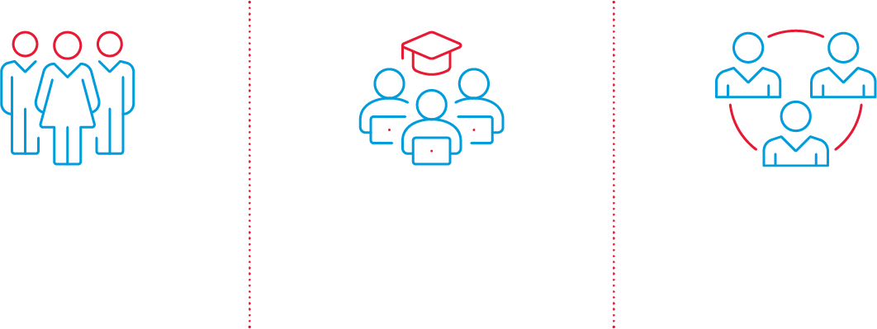
We are …
Physicians’ powerful ally in patient care.
Largest medical association in the nation
Nearly 52,000 medical student members (almost half of all students)
And why do people like you join?
To have an impact on the medical profession and patient care.

Slide 7

What can we do for you?
Supporting you today. Protecting your future.
© 2023 American Medical Association. All rights reserved.

Slide 8


What can we do for you?
The AMA is fighting to protect your investment in your medical education, your training, your future.
BIG picture: AMA represents the with a unified voice to …
PROFESSION
Reduce administrative burden and excessive prior authorization
Reform Medicare payment and ensure proper reimbursement
Support physician well-being and fight burnout
Prevent scope of practice expansions and ensure physicians remain leaders of the health care team

Slide 9


What can we do for you?
The AMA is fighting to protect your investment in your medical education, your training, your future.
AMA takes on issues/topics that matter to
MEDICAL STUDENTS
Advocating for maternal health in light of Supreme Court decision on Dobbs
Confronting racism as a public health threat
Defending Title IX
Taking on LGBTQ+ health issues and advocacy
Treating gun violence as a health threat

Slide 10


What can we do for you?
The AMA is fighting to protect your investment in your medical education, your training, your future.
AMA is supporting today as a medical student, and protecting future as a physician
you
YOUR
Leadership and training opportunities to help distinguish you as a candidate for residency and resources to find the right Match
Free access to the JAMA Network™ and research resources to help you navigate the research path and bolster your CV
Discounts on everything from test prep to travel
Connections to a passionate, active network of fellow members

Slide 11
More AMA student member benefits
Savings and exclusive offers
© 2023 American Medical Association. All rights reserved.

Slide 12
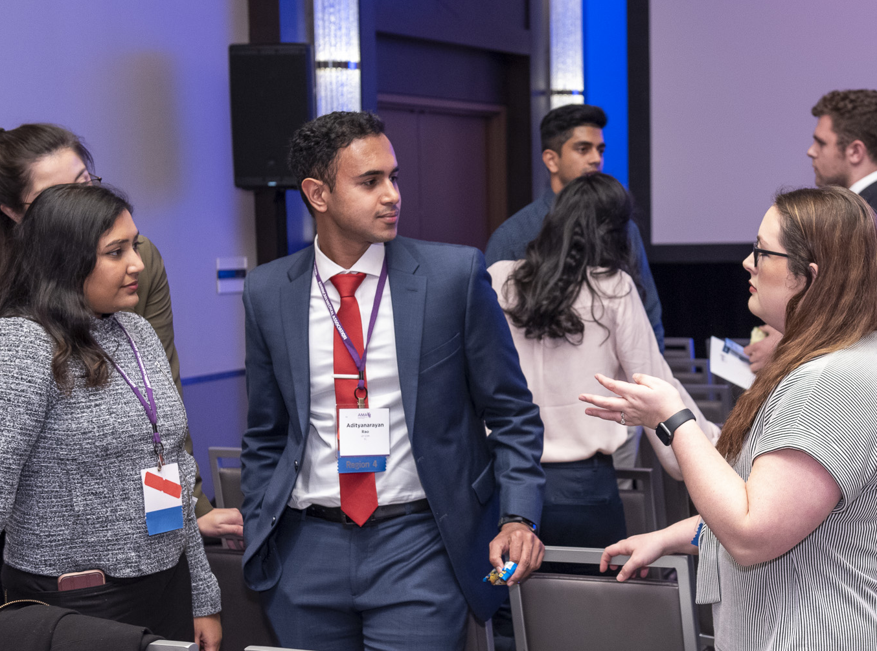
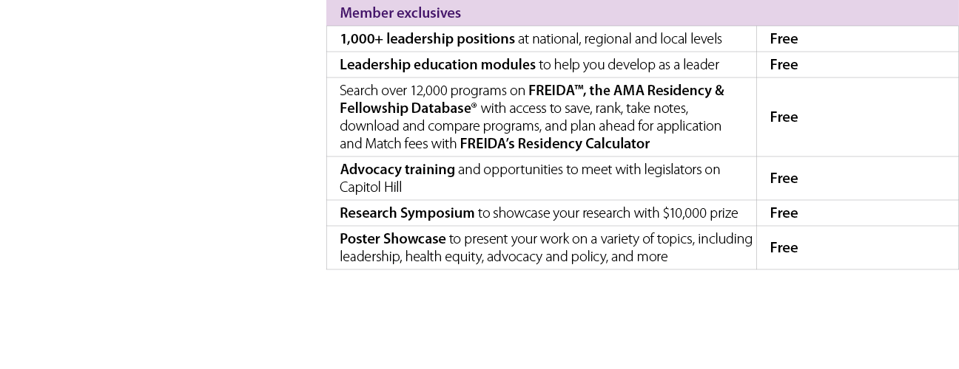
Access to exclusive offers
Designed to enhance your personal and professional life

Slide 13

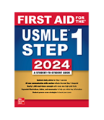
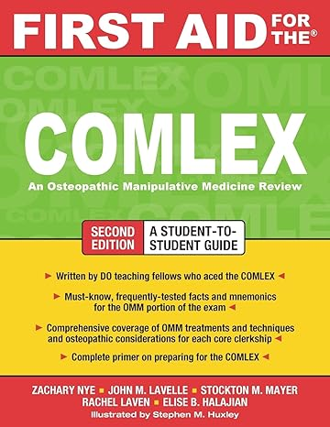



Membership Welcome gifts
Select any one of these top-tier study aids when you join the American Medical Association.*
First Aid for the USMLE 2024 (pre-order 2025) OR First Aid for the COMLEX
Up to $60 off UWorld USMLE® or
COMLEX-USA® QBanks
3-month subscription Steps 1 or 2-3
3-month subscription to Kaplan’s USMLE® Step 1 or COMLEX-USA® Level 1 Qbank
* Limit one (1) Welcome gift per eligible four-year AMA student membership. Subject to change. While supplies last.

Slide 14

Join today and select your gift.
Supporting you today. Protecting your future.
Four-year medical student membership, only
That’s just
$68!
$17 a year.
Text MSOP to 62802

Slide 15


THANK YOU
Joel Bervell, future physician
Member since 2021
Alina Khan, future physician
Member since 2023
Ellie Laughlin, future physician
Member since 2022
© 2023 American Medical Association. All rights reserved.

