Slide 1

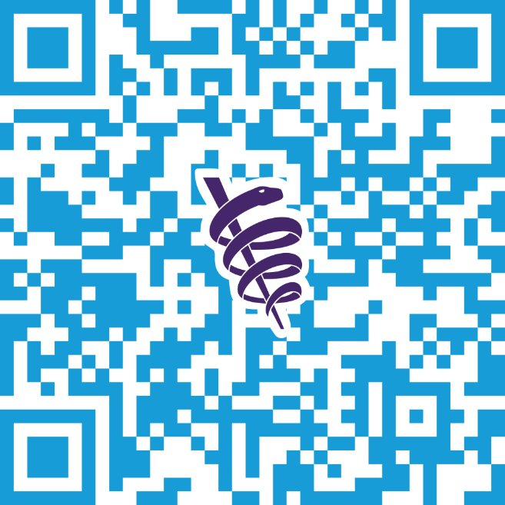
$10,000 Prize at Largest Research Symposium
FREE for AMA members. Enter for the chance to:​
Showcase your research​
Enhance your CV​
Win a $10,000 grand prize​
​
Deadline to submit is July 16.​
​
​
​
​
ama-assn.org/researchchallenge

