Slide 1
Medicare Physician Payment: QPP Requirements for 2018
January 2018
Rev. 1/26/18

Slide 2
Some general observations
QPP created by MACRA is complex
Most of the “new” requirements are really revisions to the legacy FFS programs
Perceptions/ understanding shaped by participation in legacy programs
Those who chose to accept penalties before may still decline to participate
Penalties less severe than combined legacy programs
One goal of MACRA was to simplify administrative processes for physicians
Many improvements in effect now
There is more work to do
Improving the practice environment is a high priority for the AMA

Slide 3
MACRA established two Medicare paths for physicians
MACRA was designed to offer physicians a choice between two payment pathways:
A modified fee-for-service model (MIPS)
New payment models that reduce costs of care and/or support high-value services not typically covered under the Medicare fee schedule (APMs)
In short-term, most are expected to participate in MIPS
CMS named the physician payment system created by the Medicare Access and CHIP Reauthorization Act (MACRA) law the Quality Payment Program (QPP)
MIPS
APMs

Slide 4
QPP eligibility
Reason for exclusion | No. TIN/NPIs (2017) | No. TIN/NPIs (2018)
All Medicare clinicians billing Part B | 1,380,209 | 1,548,022
MIPS ineligible types | -199,308 | -233,289
Newly enrolled | -85,268 | -81,954
Low volume | -383,514 | -540,347
Qualifying APM participants | -70K-120K | -70,732
Eligible clinicians who can report under MIPS | 43-47% | 621,700 40%
Eligible clinicians include:
Physicians (includes dentists, podiatrists, optometrists, some chiropractors)
Physician Assistants
NPs, CRNAs, Clinical Nurse Specialists
Exempt clinicians include:
Those in first year billing Medicare
Participants who receive 25% Medicare payments or see 20% Medicare patients through Advanced APMs
Those below a low-volume threshold (LVT)
LVT raised in 2018, from $30,000 or 100 patients to $90,000 or 200 patients

Slide 5
Low-volume threshold exemption
Clinicians with annual Medicare allowed charges of $90,000 or less, or 200 or fewer Medicare patients exempt from QPP
Threshold increased from 2017 levels of $30,000/100 patients
Eligibility calculated by CMS
Based on 12-month historical data (previous September-August)
Includes Part B drug costs, but not Part D
Visit www.qpp.cms.gov, enter your NPI to check eligibility for the current year
For group reporting: low-volume physicians who are members of a group that exceeds the threshold must still participate in MIPS
Exempted physicians receive annual fee schedule updates, but no bonuses or penalties

Slide 6
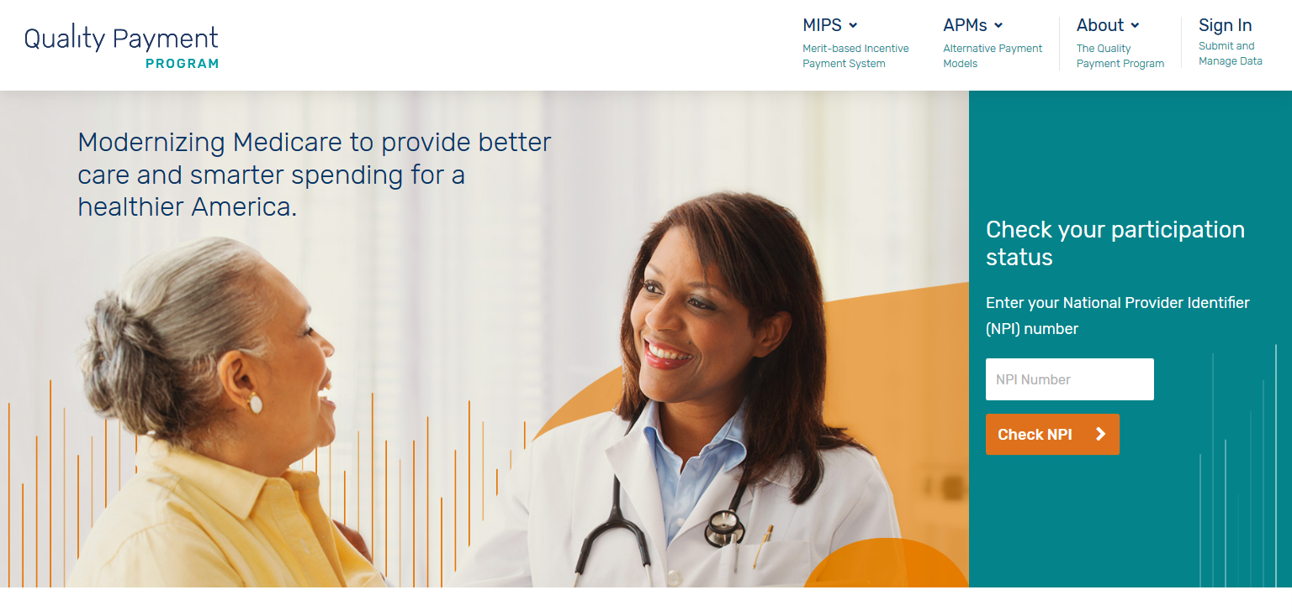
www.qpp.cms.gov

Slide 7
Accommodations for small practices
https://qpp.cms.gov/about/small-underserved-rural-practices
In effect for 2017
Pick your pace MIPS transition (reporting a single quality measure provided exemption from penalties)
Scores for IA reporting doubled
2018 accommodations
Low-volume threshold raised to $90K/200 patients
Low-volume threshold $30K/100 patients
$100 million in grants for technical assistance via QIOs and regional health improvement collaboratives
Virtual group option created
ACI hardship exemption for small practices
Bonus points added to final score for small practices
Doubled IA scores continued
Technical assistance grants continued
Favorable Quality scoring

Slide 8
Merit-based Incentive Payment System (MIPS)

Slide 9
MIPS components and scoring weights
MIPS aims:
Align 3 current independent programs
Add 4th component to promote improvement and innovation
Provide more flexibility and choice of measures
Retain a fee-for-service payment option
2018 changes:
Quality weight decreased from 60% to 50% (will be 30% in 2019)
Cost weight increased from 0% to 10% (will be 30% in 2019)
MIPS
50% Quality Reporting (was PQRS)
10% Cost (was Value-based Modifier)
25% Advancing Care Information (was MU)
15% Improvement Activities

Slide 10
MIPS Quality component—full year reporting
Legacy PQRS
9 measures
Pass/fail approach
2017 Quality
6 measures (or one specialty set)
Partial credit allowed
2018 changes
2017 modifications mostly retained
Cross cutting measures removed from most sets (except IM, FM, Ped)
2% penalties, no bonuses
Measures must fall across multiple domains
One cross cutting measure required
Flexibility in measure choice
No domains or cross-cutting measures required
Bonuses for electronic reporting
New and modified specialty measure sets available
50% data completeness required for successful measure reporting
Completeness threshold raised from 50% to 60%
Incomplete measures earn 1 point (3 for small practices)

Slide 11
MIPS ACI requirements—90-day reporting
Legacy Meaningful Use
100% score required on all measures
Included redundant quality measures
2017 ACI
Pass/ fail replaced with base and performance scoring
4 base measures required, partial credit allowed for performance measures
2018 changes
2017 improvements retained
Will not require updates to 2015 CEHRT in 2018 (10% bonus if using)
Included problematic CPOE, CDS measures
Full-year reporting (although twice reduced in Q4)
Fewer measures; no CPOE, CDC, or clinical quality measures
Performance score thresholds eliminated
90-day reporting
Bonuses available for registry reporting and use of CEHRT in IA
Increased opportunities for bonus points
Hardship exemptions created for small practices, physicians with decertified EHRs, hospital-based clinicians (including off-campus) , ASC-based clinicians
May report modified MU stage 2 measures instead of advancing to new stage 3 measures

Slide 12
MIPS Cost component (calculated by CMS via claims)
Legacy value-based modifier
Included both quality and resource-use measures
Double jeopardy; PQRS failure penalized twice
2017 Cost
Focus solely on cost
No double-jeopardy
2018 changes
2017 structural improvements maintained
Weight increased to 10%
Flawed measures with poor risk adjustment penalized those treating sickest patients
No statutory limits on penalty risk
10 contractor-developed episode measures added
Drug calculations unchanged
0% MIPS component weight in 2017; informational reports on legacy measures provided FYI only
10 episode groups eliminated
Cost scores based on two legacy measures
Measured total cost of care per capita and Medicare spending per (hospitalized) beneficiary
Part B (but not Part D) drugs included in calculation
Contractors and clinical panels developing others
Clinical panels working to develop and refine others
Part B drugs included in calculations and subject to MIPS-related pay adjustments

Slide 13
MIPS Improvement Activities (no legacy program)—90-day reporting
2017 IAs
Intended to give credit for practice innovations that improve access and quality
Participation in MIPS APMs and certified PCMHs earn full score in 2017
2018 changes
Requirements and scoring unchanged
CPC+ added to the MIPS APM models that earn full score in 2018
92 activities across 8 categories
No required categories
40 points needed for larger practices (2-4 activities)
1-2 activities required for groups of 15 or less, rural and HPSA practices, non-patient facing specialists (most physicians fall into these categories)
50% of practice sites within a TIN must be recognized as certified PCMHs to receive full IA credit
More activities added for total of 112, including NDPP referrals

Slide 14
MIPS reporting and scoring at a glance
MIPS component | Category weight | Reporting period | Reporting options | Points | Bonuses available
Quality | 50% | 12 months | Claims (individuals), EHR, qualified registry, QCDR, web interface (groups 25+) | 3 for complete measures 1 point for incomplete measures (special rules for topped out measures, small practices, benchmarked measures) | Up to 10% for high priority measures Up to 10% for end-to-end electronic reporting 10 points possible for improvement
ACI | 25% | 90 days | EHR, attestation, GCDR, qualified registry, QCDR, web interface (groups 25+) | 100 total 50% base score Up to 10% for each performance measure | 5% for public health or QCDR reporting 10% for using CEHRT for IA 10% bonus for using only 2015 CEHRT, Stage 3 measures
IA | 15% | 90 days | Attestation, EHR, qualified registry, QCDR, web interface (groups 25+) | 10 points for medium 20 points for high 40 points = full score | Points doubled for small practices
Cost | 10% | 12 months | Calculated by CMS | Average of 2 measures (or 1 if both can’t be scored) | 1 point possible for improvement

Slide 15
Ways clinicians can report
Individual
NPI and TIN
Group
2 or more clinicians (NPIs) who have reassigned their rights to a single TIN
APM entity
Virtual Group (New)
Solo practitioners and groups of 10 or fewer EPs who come together virtually

Slide 16
2018 performance year timeline
2018
March 31, 2019
2019
2020
2018 Performance Year
Opens Jan. 1
Closes Dec. 31
Clinicians care for patients and record data during the year
Deadline for submitting data
CMS provides performance feedback after data submission, before start of next payment year
Payment adjustments prospectively applied to each claim starting Jan. 1

Slide 17
Key events in Q1 2018
Jan. 1: Begin 12-month MIPS Quality data collection for 2018
During Q1, make preparations for ACI and IA data collection for 2018 (90-day reporting)
Jan. 1 through March 31: Report 2017 MIPS data to CMS
Not applicable for 2017 Quality data reported via claims, including Pick Your Pace
Spring 2018: Payment adjustments reflecting 2016 performance under legacy PQRS, MU, VBM will be made
These adjustments are unrelated to MACRA/ QPP

Slide 18
Performance thresholds and payment adjustments
2017
Threshold for bonuses/cuts set at 3 points
Threshold for exceptional bonus set at 70 points
2018
Threshold for bonuses/ cuts set at 15 points
Potential adjustments in 2020 +/- 5%
Additional performance threshold starts at 0.5 and goes up to 10%
Potential adjustments in 2019 +/-4%
Threshold for exceptional bonus remains 70 points
Complex patient bonus up to 5 points
Small practice bonus 5 points
Adjustment applied to Medicare paid amount
15 point examples from CMS:
Report all Improvement Activities
Meet ACI base score and report 1 quality measure that meets data completeness criteria
Meet ACI base score and one medium weighted Improvement Activity
Submit 6 quality measures that meet data completeness criteria

Slide 19
Bonus points
Formerly available
Up to 5% ACI bonus for reporting to one or more additional public health and clinical data registries
Up to 10% ACI for reporting certain Improvement Activities via CEHRT
New for 2018
For complex patients, up to 5 points available based on combination of Hierarchical Conditions Category (HCC) risk score and number of dual eligibles treated
Small practice bonus of 5 points added to final score for practices of 15 or fewer
Additional Quality points for: (1) electronic reporting; (2) reporting on CG-CAHPS survey measure; (3) additional outcome or high priority measure
Potential points for improvements in Cost and Quality components
10% bonus for using only 2015 CEHRT

Slide 20
2019 and 2020 penalty risks compared
Legacy programs | Potential adjustments
PQRS | -2%
MU | -5%
VBM | -4% or more*
Total penalty risk | -11% or more*
Bonus potential (VBM only) | Unknown (budget neutral)*
MIPS factors | 2019 scoring | 2020 scoring
Quality measurement | 60% of score | 50% of score
Advancing Care Info. | 25% of score | No change
Cost | 0% of score | 10% of score
Improvement Activities | 15% of score | No change
Total penalty risk | Max of -4% | Max of -5%
Bonus potential | Max of 4%, plus potential 10% for high performers | Max of 5%, plus potential 10% for high performers; bonus points available for complex patients, small practices
*VBM was in effect for 3 years before MACRA passed, and penalty risk was increased in each of these years; there were no ceilings or floors on penalties and bonuses, only a budget neutrality requirement.

Slide 21
Payment adjustments 2019 and 2020
2017 final score | 2019 payment adjustment
> 70 points | Positive adjustment Eligible for exceptional performance bonus of at least 0.5%
4-69 points | Positive adjustment Not eligible for exceptional performance bonus
3 points | No adjustment
0 points | -4% negative adjustment
2018 final score | 2020 payment adjustment
> 70 points | Positive adjustment Eligible for exceptional performance bonus of at least 0.5%
15.01-69.99 points | Positive adjustment Not eligible for exceptional performance bonus
15 points | No adjustment
3.76-14.99 points | Negative adjustment between 0% to -5%
0-3.75 points | -5% negative adjustment

Slide 22
New provision: Improvement scoring for Quality and Cost
MACRA calls for rewarding improvement as well as overall score
Second year of QPP provides first opportunity
For Quality: improvement score based on rate of improvement in total Quality score
Greater improvement results in more points; lower performance in transition year could produce highest improvement score
Up to 10 percentage points available
For Cost: score based on statistically significant changes at the measure level
Up to 1 percentage point available
If data are insufficient in either category, improvement score will be 0 percentage points
Only positive adjustments are possible. No penalties for falling scores.

Slide 23
New provision: Virtual Groups
Must include at least 2 solo and small group (<10) clinicians
No restrictions on locations or specialties or number of TINs that may participate
MIPS Virtual Group Identifiers will be created by CMS; individual clinicians identified through combination of VGI, TIN, and NPI
All practices in virtual groups must be eligible for MIPS
A participating group may include a clinician who is not eligible (e.g., does not meet LVT), but group as a whole must be eligible
All eligible clinicians under the TIN would be included in the virtual group
Requirements
Formal written agreement between each virtual group member (model agreement being developed)
Must elect by December prior to performance year (for 2018, election process ran from 10/11-12/31)
May only participate in one virtual group during a performance period

Slide 24
Potential advantages of virtual groups
Share burden of MIPS reporting
Combine credit for MIPS categories like Improvement Activities
Combine patient counts in quality reporting for more reliable sample sizes
Maintaining independence
Take advantage of group reporting options
Non-patient facing MIPS clinician and small practice, rural area, and HPSA designation would apply
CMS will provide technical assistance
Challenges:
IT infrastructure lacking
Different EHR systems
Workflow and staff training changes

Slide 25
Alternative Payment Models (APMs)

Slide 26
APMs participation options as outlined by CMS
“Advanced” APMs have greatest risks and offer potential for greatest rewards
Qualified Medical Homes have different risk structure but otherwise will be treated as Advanced APMs
MIPS APMs receive favorable MIPS scoring
Physician-focused APMs are under development
Physician-focused APMs TBD
Advanced APMs
and Qualified Medical Homes
MIPS APMs

Slide 27
CMS criteria for Advanced APMs
50% of participants must use certified EHR technology
Must report and at least partially base clinician payments on quality measures comparable to MIPS
Bear “more than nominal risk” for monetary losses
Defined as the lesser of 8% of total Medicare revenues or 3% of total Medicare expenditures (through 2020)
Primary Care Medical Home models with < 50 clinicians have different standards (2.5%-5% total Medicare revenues in annual steps until 2021)
Round 1 CPC+ practices may exceed 50 clinicians
First-year 2.5% risk maintained in 2018, delaying originally scheduled 2020 max date
APM participation may now begin or end mid-year; future payments based on dates of participation (at least 60 continuous days)
Advanced APMs
EHR use
Quality Reporting
Financial
Risk

Slide 28
MACRA incentives for Advanced APM participation
Model design
APMs have shared savings, flexible payment bundles and other desirable features
Bonuses
In 2019-2024, 5% bonus payments made to physicians participating in Advanced APMs
Higher updates
Annual baseline payment updates will be higher (0.75%) for Advanced APM participants than for MIPS participants (0.25%) starting 2026
MIPS exemption
Advanced APM participants do not have to participate in MIPS (models include their own EHR use and quality reporting requirements)

Slide 29
Models qualified in 2018 as Advanced APMs
Comprehensive ESRD Care Model
(Subset of 37 ESCOs qualify)
Comprehensive Primary Care Plus
(2,816 Round 1 practices + 165 Round 2)
ACOs:
Tracks 1+, 2, 3 NextGen, Vermont
(159 ACOs + VT)
Bundled Payments for Care Improvement Advanced
(starts 10/1/2018)
Oncology Care Model Track 2
(Subset of 192 practices qualify)
Comprehensive Joint Replacement
(Subset of participants in 67 MSAs qualify)

Slide 30
Timeline for determining eligibility and bonuses
Qualified Medicare APM participants identified by CMS via 3 “snapshots”: March 31, June 30, August 31
Physicians listed as participants on one of those dates will be considered participants for that performance year
Performance of all participants in an APM entity to be judged as a whole
New flexibility provided to allow start-up APMs to participate
Performance score based on at least 60 continuous days of participation
Performance year ends August 31
Provides time for MIPS reporting for those not meeting thresholds
5% bonus will be calculated on Medicare revenues for second calendar year
Lump sum payment provided in third calendar year
Example of bonus calculation timeline:
2017 performance year determines eligibility (as of August 31)
2018 year-end revenues provide base for calculating bonus
Lump sum bonus payment mid-2019 after all 2018 claims are submitted

Slide 31
New all-payer APM combination option
Available beginning 2019 performance year
Option only for clinicians who fail to become qualified APM participants under the Medicare only APM pathway
Clinician, EPM entity or payers must submit applications to CMS
Medicaid, Medicare Advantage, and CMMI multi-payer models may submit arrangements
Will be expanded to commercial payers and other non-Medicare/Medicaid plans in future years
Model requirements similar to Medicare advanced APMs
Eligible clinicians have option of being assessed at individual or APM entity level
Score will be based on Medicare-weighted threshold at group level, if entity score is higher than individual EP score

Slide 32
MIPS APMs
Criteria
APM entity participates in a model under an agreement with CMS
Other benefits
2017 MIPS APMs receive full Improvement Activities credit (could vary in future years)
Advanced APM benefits do not apply
Must participate in MIPS to receive any favorable payment adjustments
Do not qualify for 5% APM bonus payments 2019-2024
Not eligible for higher baseline annual updates beginning 2026
Eligible for annual MIPS bonuses, which continue indefinitely (vs. 6 years for 5% APM bonuses)
Models have different MIPS reporting (no Cost score; Quality is 50%, IA is 20%, ACI 30%)
Entity includes at least one MIPS eligible clinician on a participant list
Payment incentives based on performance on cost and quality measures (either on entity or individual clinician level)
2017 qualified models
MSSP Track 1 counts
APM-specific rewards (e.g., shared savings, guaranteed payments)

Slide 33
MIPS APMs: All Advanced APMs below threshold PLUS
ACO Track 1
(438, 91% of total)
Oncology Care Model Track 1
Comprehensive ESRD Care Model
1-sided risk

Slide 34
Resources

Slide 35
CMS resources
www.qpp.cms.gov
TCPI and SAN networks
Technical assistance in 50 states for primary care and specialists
https://innovation.cms.gov/initiatives/Transforming-Clinical-Practices/
Small, Underserved, and Rural Support
Assistance tailored to needs
11 SURS providing assistance in all states, DC, PR, VI
QIN-QIO
Support for large practices (over 15 clinicians)
https://qpp.cms.gov/about/small-underserved-rural-practices
14 QIN-QIOs in all 50 states, DC, PR, VI
www.qioprogram.org

Slide 36
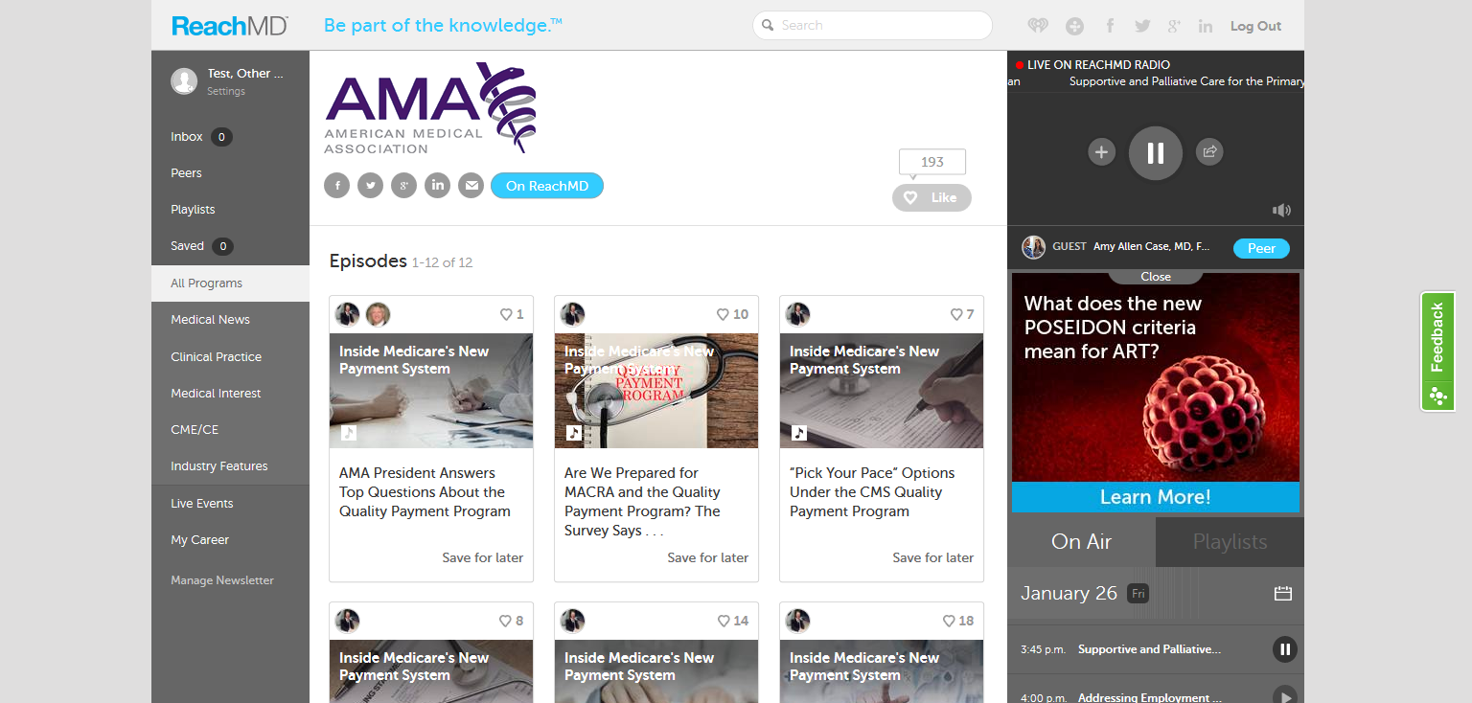
www.ReachMD.com/AMA

Slide 37
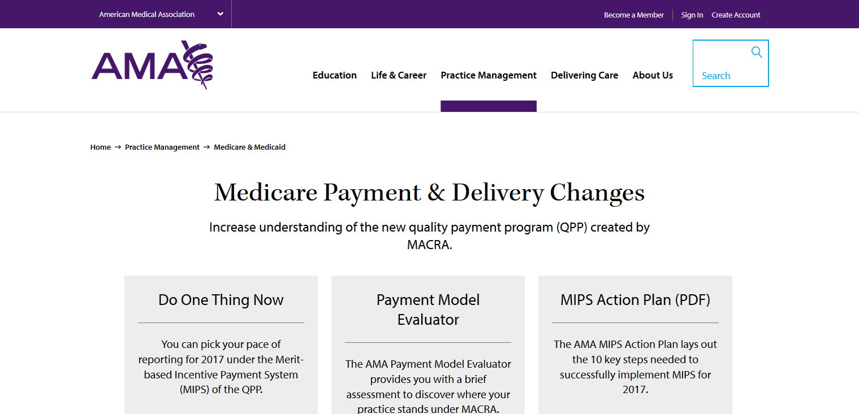
AMA resources on quality payment program
Links and tabs to:
10 Step MIPS Action Plan
Pick Your Pace video and instructions
Detailed info on MIPS and APMs
STEPSForward modules
AMA Payment Model Evaluator
Podcasts from ReachMD
Links to specialty and state society MACRA resources
Link to qpp.cms.gov
Other MACRA resources, links, and news stories, as well as AMA comments and recommendations
www.ama-assn.org/medicare-payment

Slide 38
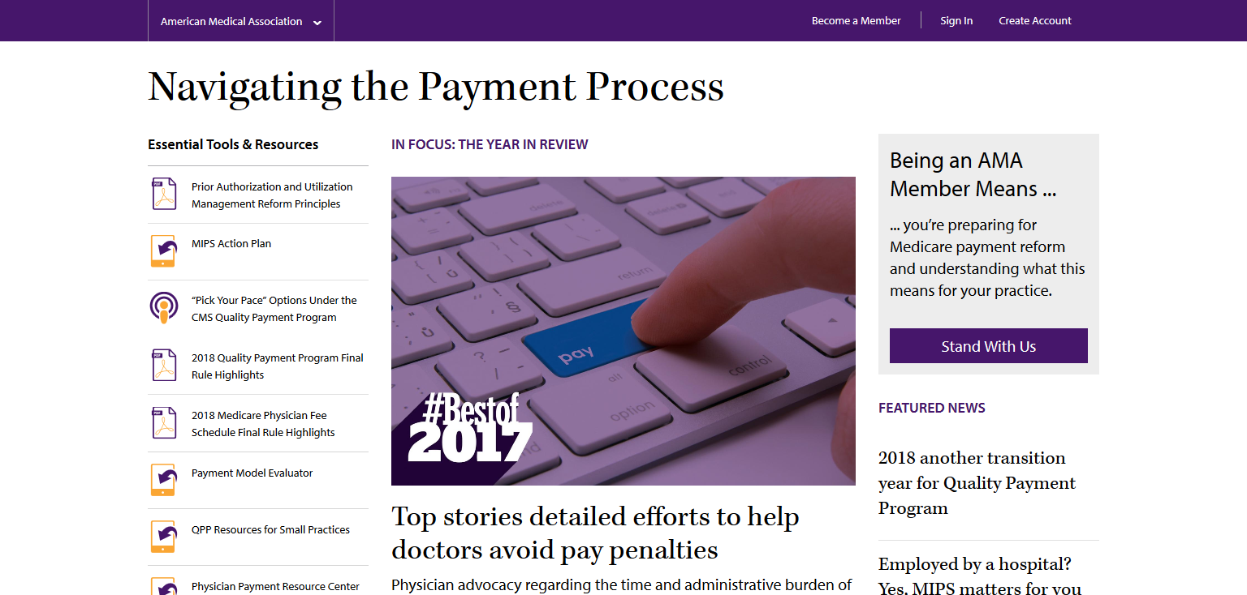
https://www.ama-assn.org/navigating-payment.

